Slide 1
CS294: AI for Systems and Systems for AI Logistics, Overview, Trends
Joey Gonzalez and Ion Stoica
January 23, 2019

Slide 2
Course Information
Course website:
https://ucbrise.github.io/cs294-ai-sys-sp19/
It is on Github so you can contribute content!
Please subscribe to piazza:
http://piazza.com/berkeley/spring2019/cs294159/home
Schedule and reading list are subject to change

Slide 3
Tentative Lecture Format (not today!)
First 1/3 of each lecture presented by faculty
Second 2/3 covers papers presented by students
Two presentations of 15min each, followed by 20min discussion

Slide 4
Reading assignments
All students are required to read all papers
All students are required to submit “reviews” for each paper:
Answer short questions on google form: identify key insights, strengths and weaknesses
We will send out how to signup for papers later today

Slide 5
Grading Policy
40% Class Participation
Answer questions, join discussion, and present papers
10% Initial Project Proposal Presentation
Presented in class on 3/11
25% Project Poster Session
TBA
25% Final Project Reports
TBA

Slide 6
What do you expect from this class?

Slide 7
Main goal
Identify and solve big/impactful problems at the intersection between AI and Systems

Slide 8
How?
Study:
Major AI developments through systems’ lens
System-related problems that might leverage AI techniques
Enable System and AI students to collaborate on projects
Play to Berkeley’s strengths
World-class in both AI and Systems
Long tradition of collaboration between AI and Systems

Slide 9
A Short Story…

Slide 10
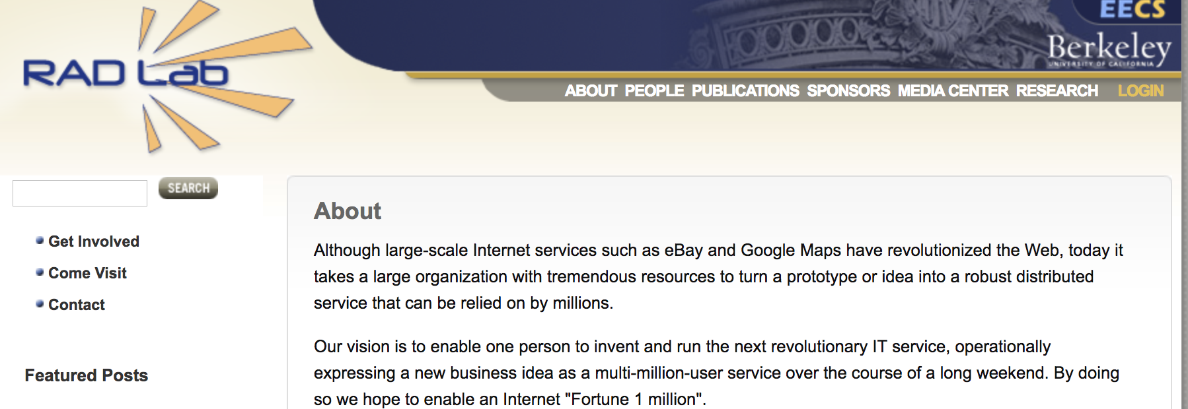
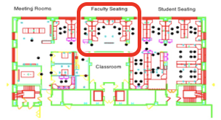
2006-2011

Slide 11








2006-2011

Slide 12
2006-2011
ML
Systems,
Networking
Databases

Slide 13
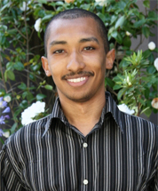
2009
Prize
anonymized movie rating dataset
best recommendation algorithm
$1m
Lester Mackey
(postdoc w/ Michael Jordan)

Slide 14


Slide 15

Lester Mackey
Matei Zaharia

Slide 17
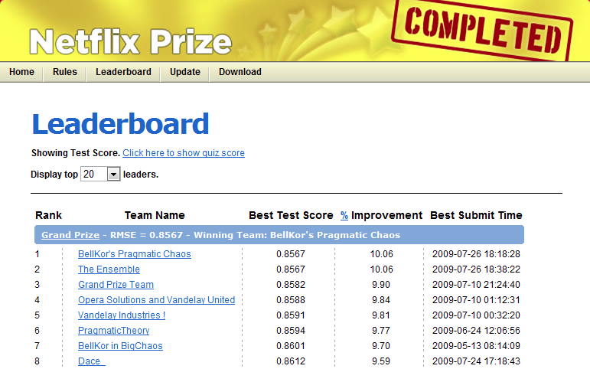
tied for best score
20 mins late

Slide 18
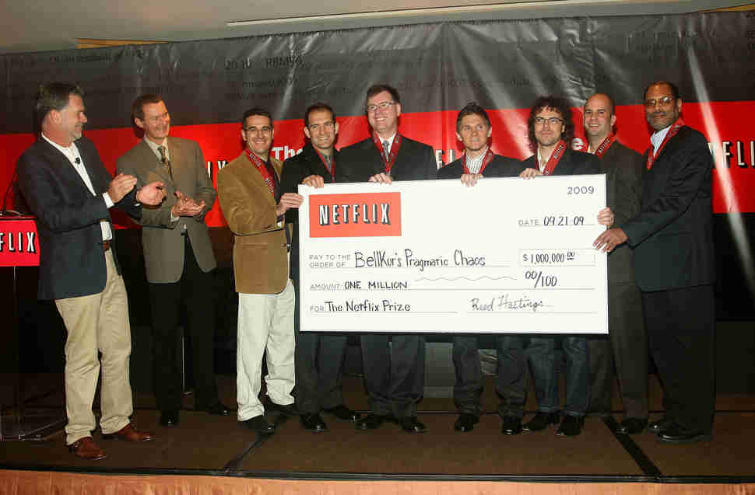

Slide 19
Meanwhile…
Joey morphing from an ML to a system student ;-)

Slide 20
Today
Jeff Dean’s favorite talk about how
AI can get rid of all hacks and heuristics in systems
And how hardware & software can revolutionize AI

Slide 21


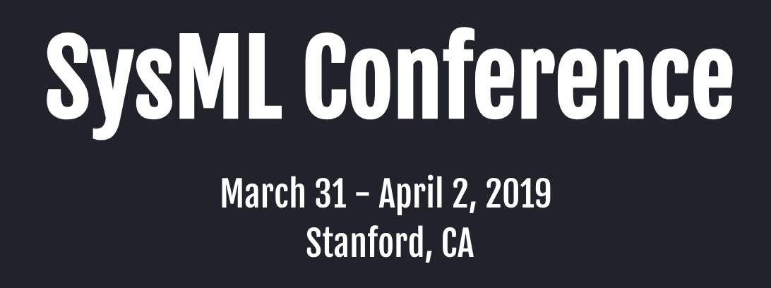
Proliferation of venues…

Slide 22
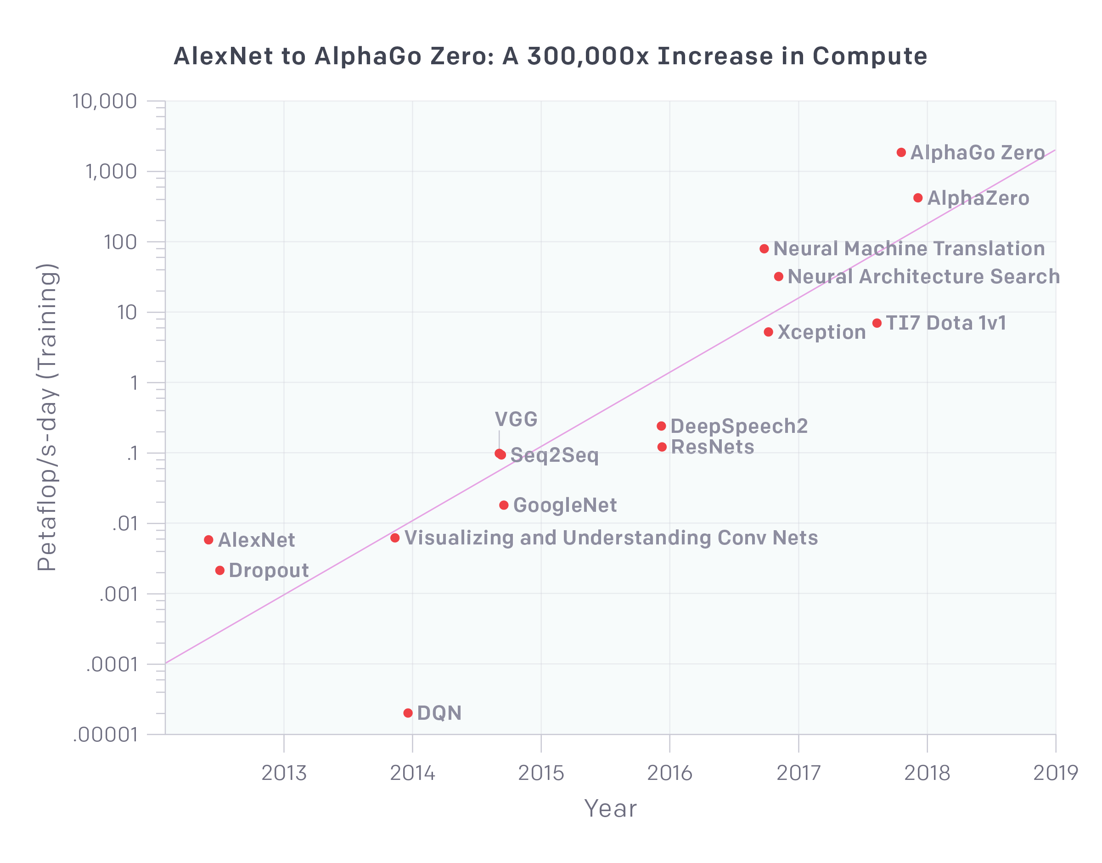
The need for systems
AI and Compute (https://blog.openai.com/ai-and-compute/)

Slide 23
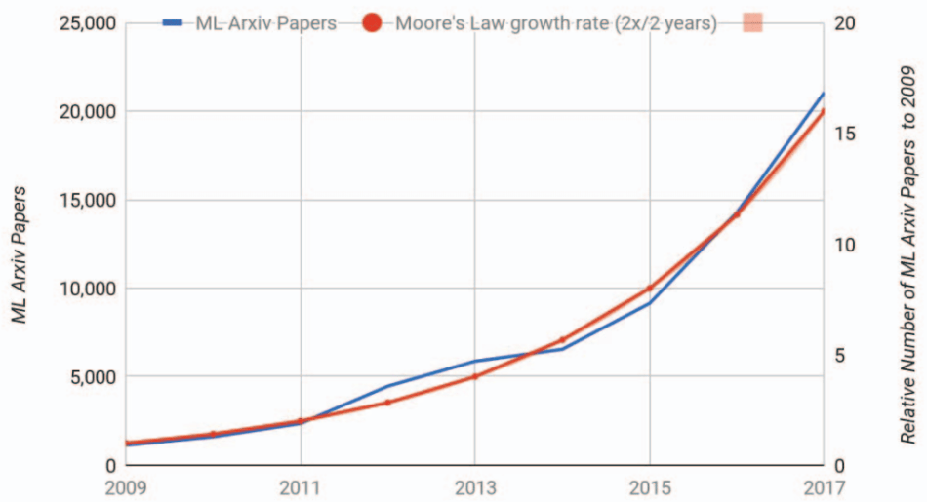
How do you rise above the “noise”?
“A New Golden Age in Computer Architecture: Empowering the Machine-Learning Revolution”,
https://ieeexplore.ieee.org/document/8259424

Slide 24
Work on great problems!

Slide 25
Disclaimer
My (biased) opinion
Based on my experience
Not the only path to success

Slide 26
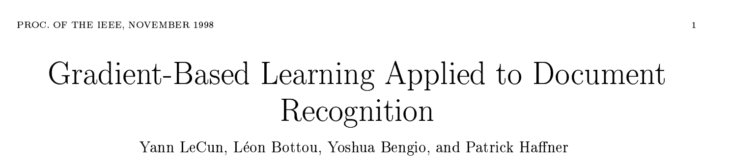
You want “proof”?
How did the last AI revolution started?
Providing state-of-the-art results on OCR
16,000+ citations

Slide 27
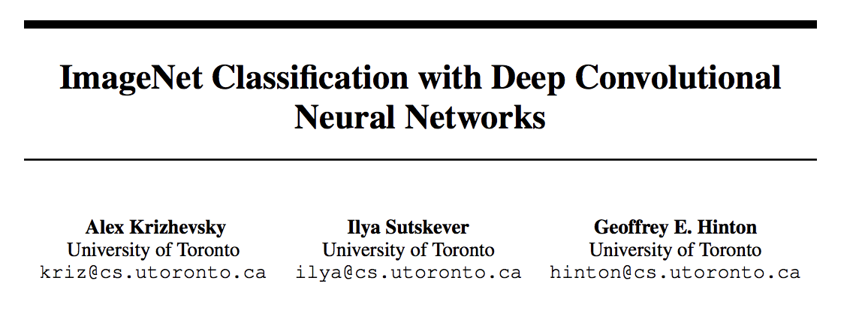
You want “proof”?
How did the last AI revolution started?
Providing state-of-the-art results on image recognition
34,500+ citations

Slide 28
Another line of argument…
All of you are good problem solvers
Good grades
Good scores
…
As such, the biggest differentiator is the problem you are working on

Slide 29
What is a good problem to work on?
Impact: someone cares about solving the problem
The more people care, the better
Priority: you are among the first to work on the problem
Increases the chances of being first to solve this problem
Caveat: This is just “nice to have”. If you believe it’s an important problem and you are passionate bout it, go for it!
Edge: You have an expertise (edge) to solve the problem
Incremental: can be partitioned into sub-problems
Help you make rapid progress, iterate, better understand the problem

Slide 30
Some problems I worked on
Problem | Impact (problem formulation) | Priority | Edge | Incremental | Comments
Chord | Need for decentralized (no liability), efficient P2P system | Among several groups working on it | Experts in distributed systems and algorithms | Followed by many refinements | At some point, most cited paper
13,600+ citations

Slide 31
Some problems I worked on
Problem | Impact (problem formulation) | Priority | Edge | Incremental | Comments
Chord | Need for decentralized (no liability), efficient P2P system | Among several groups working on it | Experts in distributed systems and algorithms | Followed by many refinements | At some point, most cited paper
Spark | Need for fast, general-purpose big data analytics | Among first to see ML use cases (AMPLab) and interactive queries (industry; Conviva, FB) | Already experts in big data (in academia); started working on this 3 years earlier | Core Spark (3,000 LoC); Shark, Streaming, ML libs | High impact in industry
13,600+ citations
3,940+ citations

Slide 32
Some problems I worked on
Problem | Impact (problem formulation) | Priority | Edge | Incremental | Comments
Chord | Need for decentralized (no liability), efficient P2P system | Among several groups working on it | Experts in distributed systems and algorithms | Followed by many refinements | At some point, most cited paper
Spark | Need for fast, general-purpose big data analytics | Among first to see ML use cases (AMPLab) and interactive queries (industry; Conviva, FB) | Already experts in big data (in academia); started working on this 3 years earlier | Core Spark (3,000 LoC); Shark, Streaming, ML libs | High impact in industry
Dominant Resource Fairness (DRF) | Need for better utilization for multi resource types workloads | Among first to see the problem (Mesos) | Experts in scheduling algorithms | Followed by other papers in different areas | Intellectual impact (microeconomy); implemented in a few systems
13,600+ citations
3,940+ citations
800+ citations

Slide 33
Impact (1/2)
Do things that have not been done before
“It always seems impossible until is done” – Nelson Mandela
Examples: zero-knowledge proof, beating chess/go world champion, outperform experts in medical diagnosis, …
Do things much better than before (e.g., 10x)
Examples: GPUs, Distributed Hash Tables (routing efficiency), in-memory databases, CNNs, …

Slide 34
Impact (2/2)
Theory
Improve space/time complexity of wide used algo (e.g., SGD)
Extend existing techniques to new domains/environments, e.g., fair scheduler from network to CPU, distributed graph algorithms
Prove new desirable properties for popular techniques (increase practitioners confidence in using them), e.g., show an allocation algo is strategy proof, show an algo is guaranteed to converge
Systems
Support new workloads impractical before, e.g., big data processing
Significantly improve efficiency/speed/cost, e.g., GPUs, dist algos
“Democratize” technology, e.g., cloud computing, serverless, TensorFlow

Slide 35
Priority (1/2)
You experience problem first hand
One of the main reasons we are building systems/artifacts
Build system solving a “need”
Have people use it
Understand things people want to do with your system, you haven’t thought about
Now you have a problem, you’ve “seen” first!
Take a bet on a new area and dive in
Because it’s new area, few people are working on it
This is one thing Berkeley has been excelling at, e.g.,
Complexity theory, approximate algorithms, databases, networking, sensor networks, OSes (UNIX), NOW, Big Data, ML, …

Slide 36
Priority (2/2)
Talk with people from other areas to find new problems, e.g.,
Spark motivated by Matei’s trying to solve Lester Mackey’s
Berkeley’s labs are set up to encourage you do exactly this!
“I notice that if you have the door to your office closed, you get more work done today and tomorrow, and you are more productive than most. But 10 years later somehow you don't know quite know what problems are worth working on; all the hard work you do is sort of tangential in importance. … I can say there is a pretty good correlation between those who work with the doors open and those who ultimately do important things.”
– Richard Hamming, Turing Award Winner
(“You and Your Research” : http://www.cs.virginia.edu/~robins/YouAndYourResearch.html)

Slide 37
Edge
If you do not have expertise to solve the problem, talk with people who do!
Lester leveraged Matei’s help to rank 2nd for Netflix’s challenge
Again, labs like RISELab are set up to encourage you do exactly this!

Slide 38
Incrementality
Reach the first meaningful milestone fast
Critical to get the project off the ground, maintain the excitement of the students and, if a system, start growing community
Examples: Mesos, Spark provided an useful system within 1 year
Decompose project in a series of milestones providing increasing value
Examples: Spark core → Shark (SQL) → Streaming → Mllib
Developing a chess algorithm to first beat an amateur, then a master, then a grand master, and finally the world champion
Holly grail example: Bell Labs achieving its vision of “enabling any two people in the world communicate”
Enable two people to talk by phone between Boston and NY
Enable two people to talk by phone across US between NY and SF
Enable two people to talk by phone across Atlantic between NY and London…. (see “The Idea Factory” book)

Slide 39
Questions to ask when picking a problem
What will happen if I solve this problem? Will anyone care? Will anything change in the way people do things?
If you hope for a quantitative gain, simplify the problem and see improvement; if improvement not what you hopped for, reconsider
Who else is working on the problem? (Again, big caveat here; if you believe the problem is important an you can solve it go for it!)
Why me? Do I have any edge on solving this problem? Am I expert in some techniques I think it will help me solve it? Did I solve similar problems?
Is there a meaningful milestone I can get to fast?

Slide 40
“The mere formulation of a problem is far more often essential than its solution, which may be merely a matter of mathematical or experimental skill. To raise new questions, new possibilities, to regard old problems from a new angle requires creative imagination and marks real advances in science.”
Albert Einstein (1879 - 1955) Physicist & Nobel Laureate

Slide 42
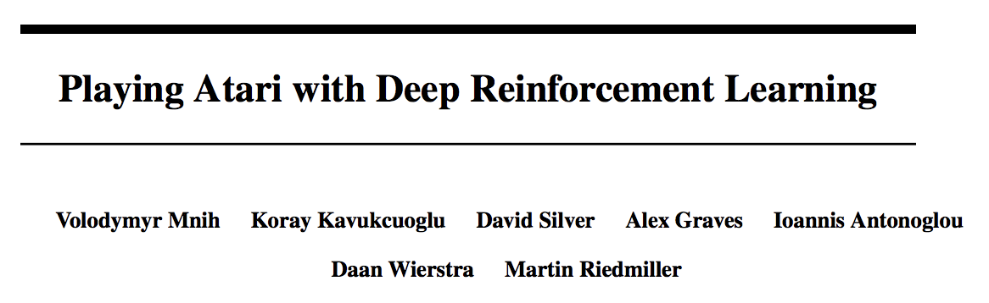
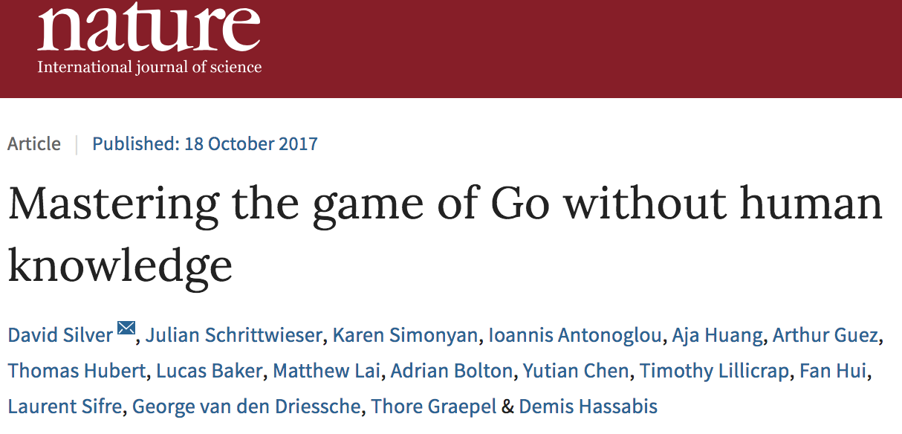
You want proof?
Why did RL become popular?
Because Atari games, Go
1,938 citations
1,143 citations

